Slide 1

Higher Education in Luzon in
S.Y. 2016-2017, S.Y. 2017-
#F8F1EA
2018, and S.Y. 2018-2019
A research of five variables to display the current situation of higher
education in Luzon for three school years.
Study Background

Slide 2

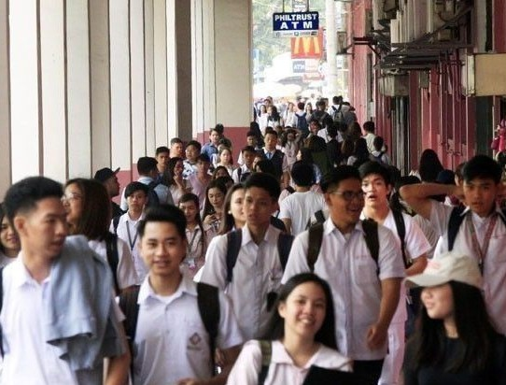
Study Background
This study aims to display the current situation of higher education in the Luzon Island, the major educational hub of the
Philippines, through:
checking whether all the colleges in Luzon are still within the range of the recommended faculty-to-student ratio; and
monitoring the progress of the colleges in Luzon for the S.Y. 2016-2017, S.Y. 2017-2018, and
S.Y. 2018-2019 through its student and faculty
population.
Image
Main Content

Slide 3
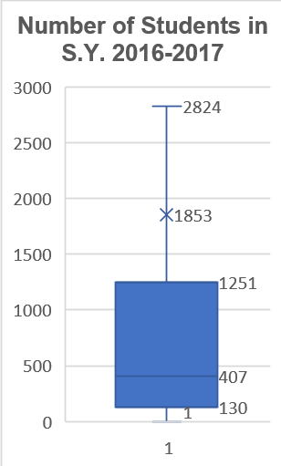
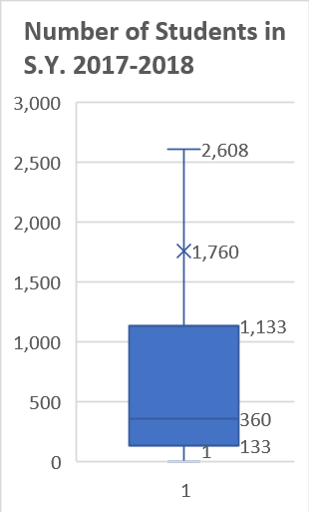
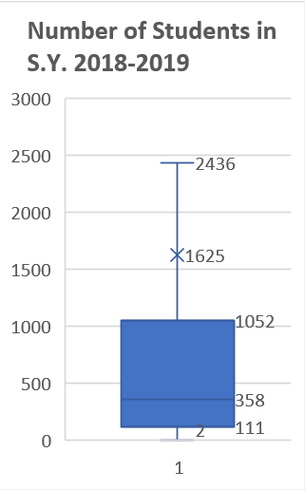

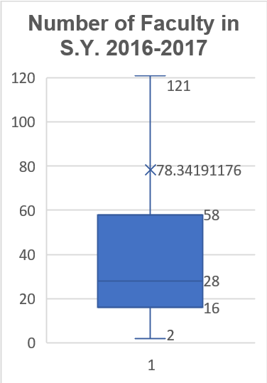
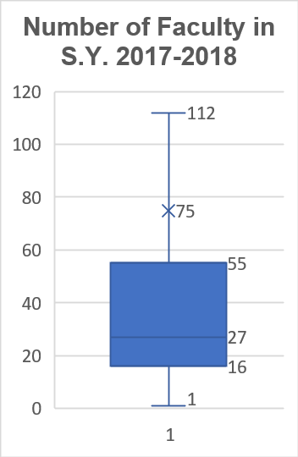
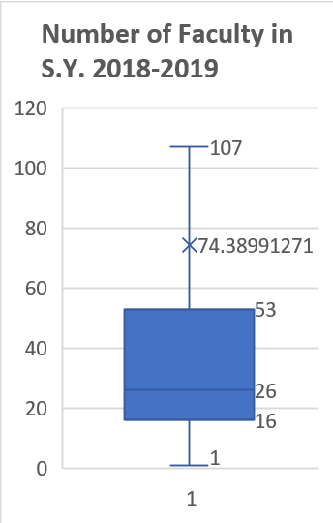
Number of Students
Number of Students

Slide 4

Faculty-to-Student Ratio

Slide 5
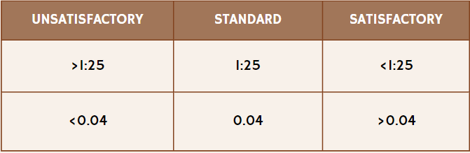
Progress of the faculty-student ratio within the three school years
S.Y.
2016-2017
2017-2018
2018-2019
MEDIAN
0.067
0.077
0.071
The Standard

Slide 6
Conclusion
Hiofthliofthts
Interpretation
Declines in the number of faculty and students in Luzon
A sign that may suggest poor leadership/high rates of drop-outs/high rates of unemployment
Faculty-to-student ratio being above 0.04 for the three school years
Good standing of the faculty-student ratio
#F8F1EA
The ideal faculty-student ratio, as stipulated by DepEd Executive Order No. 349, is 1:25 (0.04 in decimal form). These parameters suggest an improvement in the faculty-to-student ratio compared to the standard. In the academic years 2016- 2017, 2017-2018, and 2018-2019, the median faculty-student ratios for colleges in Luzon were 0.067, 0.077, and 0.071, respectively. The analysis concludes that, over these three school years, the overall faculty-student ratio in state and private colleges in Luzon remained relatively satisfactory.

Slide 7
References
Public vs Private Colleges: What's The Difference? - Crimson Education US. (n.d.).
Retrieved from Crimson Education:
https://www.crimsoneducation.org/us/blog/public-vs-private- colleges/#:~:text=However%2C%20private%20colleges%20tend%20to,other%20ac ademic%20resources%20and%20technology.
Radcliff, B. (2023, September 27). How education and training affect the economy.
Retrieved from Investopedia:
https://www.investopedia.com/articles/economics/09/education-training- advantages.asp#:~:text=Why%20Is%20Education%20Considered%20an,greater%2 0output%20and%20economic%20growth.
Salita, D. C. (2023, October 9). Manila | Philippines, Luzon, Population, Map, Climate, & Facts. Retrieved from Encyclopedia Britannica: https://www.britannica.com/place/Manila

Slide 8

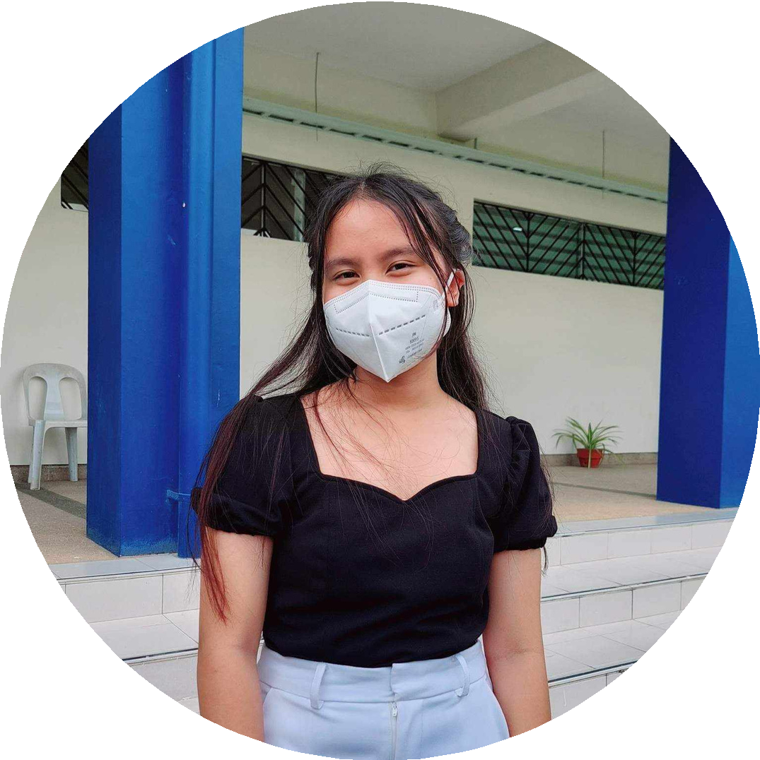


Researchers
Arlet Carpio. Currently 14 years old.
Born on August 30, 2009 in Malaybalay City, Bukidnon. Entered and studied at Malaybalay City Central School for elementary.
Currently a student at PSHS-SMC (Philippine Science High School Southern Mindanao Campus)
Estelle Maturan
Jade Dalupe

